Slide 1
MIS 6120 MOBILE COMPUTING FALL 2015, Dr. Gerald Chege
10/09/2015
1

Slide 2
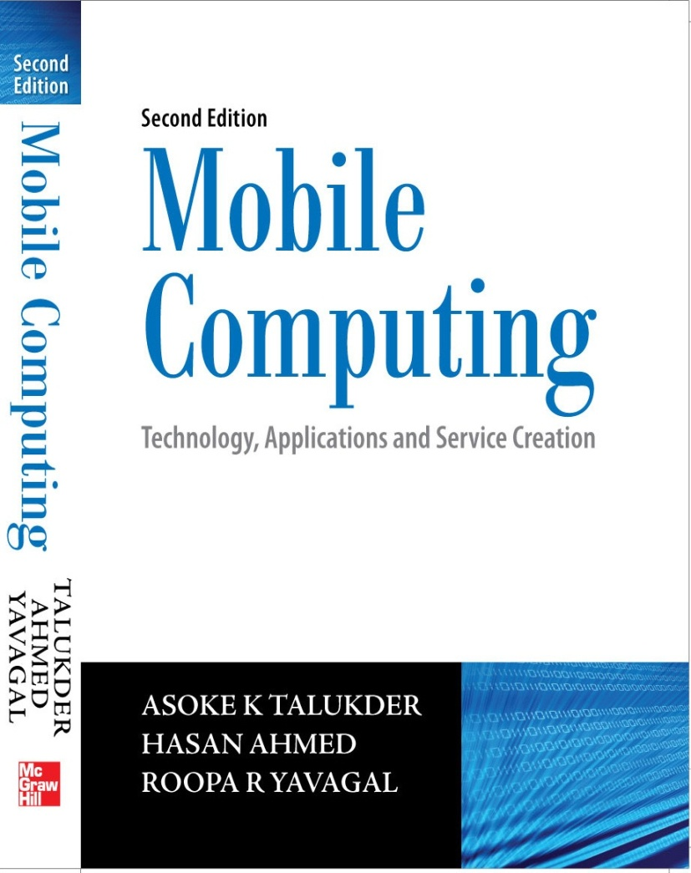
Mobile Computing
Notes#1
Introduction
© Tata McGraw Hill

Slide 3
Information … the foundation
Information is power
Information – the key ingredient of decision making process
Information – the basic differentiator between human beings and animals
Information – the driver of new technologies and concepts
Information – the underlying foundation of world’s greatest economies
Information – the currency of today’s businesses
Information – the basic need for proliferation of human civilization

Slide 4
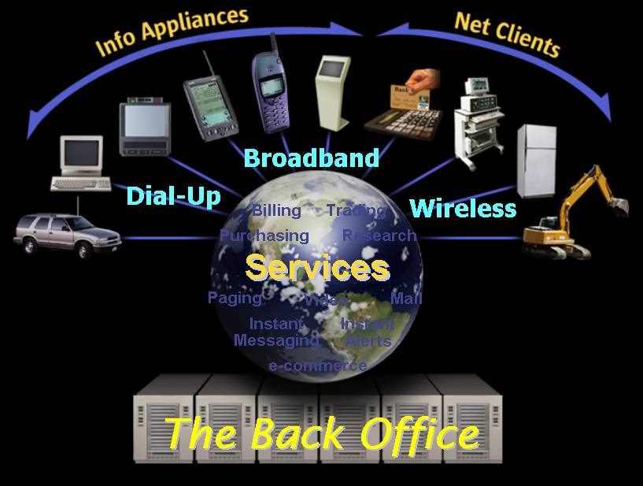
Is it fiction or fact ?

Slide 5
Where are we moving to ?
 | Yesterday | Today | Tomorrow
Computing means … | Centralized mainframes to distributed | Distributed to centralized servers | Centralized servers with ubiquitous computing, ASP, etc.
Protocols | Proprietary | Industry Standard -TCP/IP, GSM, etc. | TCP/IP, Bluetooth IEEE W LAN, CDMA, 3G, etc.
Access | Direct terminals, Private Networks, etc. | Global (restricted) through Internet & VPR | Ubiquity (anywhere, anytime, any device) through Internet & WVPR
Content | Data only | Data / Images | Data, Voice, Streaming & Real time multimedia
Access media | Character mode, Teletype, fixed wired devices, etc. | GUI, Multimedia, fixed wired device & Internet | Pervasive / Ubiquitous, wired, wireless, Internet, & Intelligent Networks
Application management | Centralized | Centralized / Distributed | Static/Mobile agents, Centralized, Distributed, etc.

Slide 6
Mobility … the basic human instinct
Mobility differentiates animals from plants
Human beings – the most adventurous and risk taking creation
Examples:
Man going to Moon
British coming to India
Indian entrepreneurs success in USA
Spread of Buddhism in far east

Slide 7
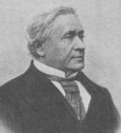
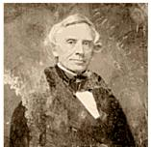
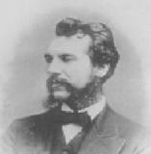
Physical to logical mobility
Early milestones of mobility
Joseph Henry sends electric current to ring a bell over one mile of wire in 1830.
Samuel F B Morse invented telegraph and sent “What hath God wrought ?” from Washington to Baltimore over 40 miles on May 24, 1844.
Alexander Graham Bell sent the first telephonic message over wire on March 10, 1876, in Boston, Massachusetts.

Slide 8
For computing while being mobile, we need …
Access to data
Access to information
Access to knowledge
Access to wisdom

Slide 9
Fruits of the past – Dotcom boom and burst
Dotcom boom established Internet as the Information Super Highway.
Appetite for data is going to increase in every sphere of social life.
Business sense makes a business sense.
Mobility is going to be the key technology driver for future.
Global service portability is going to be critical to the success of enterprises wireless proliferation.
Mobile computing is a reality.

Slide 10
Milestones for the Internet
1957 – ARPA founded following USSR’s Sputnik launch
1961 – Leonard Kleinrock, MIT – first paper on “Packet Switch”
1964 – Paul Baran, RAND, No single outage point
1965 – TX-2 at MIT Lincoln Lab and AN / FSQ-32 at System Development Corporation (Santa Monica, CA) are directly linked (without packet switches) via a dedicated 1200 bps phone line
1971 – Ray Tomlinson invents email
1972 – First public demo of Internet in ICCC, Telnet / FTP invented
1983 – 1st January TCP / IP became the Internet protocol
1991 – Tim Berners Lee invents World Wide Web
2000 – Internet boom
2002 – Dotcom bust

Slide 11
Motivations for Mobile Computing
Think of …
You are traveling. You are in a place you are not familiar with. It is quite late at night. Suddenly you had a flat tyre, or it started raining, or you need to catch a train from the nearest station.
You need to know train timing, direction to the station, or the nearest hotel with direction, or where you are, etc.
You need an alert if any of the robots goes down for more than 5 minutes.
You want to be notified if a particular mail is received in your mailbox from a very important client.

Slide 12
Mobile Computing
Can be defined as “a computing environment over physical mobility”
The user should be able to access data, information, or other logical objects from any device in any network while on the move.
It should allow a user to perform a task from anywhere using a computing device in the public, corporate and personal information spaces.
The communication bearer should be spread over both – wired and wireless media.

Slide 13
Different names of Mobile Computing
VHE – Virtual Home Environment
Anywhere, anytime information
Nomadic computing
Pervasive computing
Ubiquitous computing
Global service portability
Wearable computers
Context aware computing

Slide 14
Attributes of Ubiquity
Network Mobility
Bearer Mobility
Device Mobility
Session Mobility
Service Mobility
Host Mobility
User Mobility

Slide 15
Network Mobility
User should be able to move from one network to another network and use the same service.
Example: User moves from Nairobi to Kampala and uses the same GSM phone to access the corporate application.

Slide 16
Bearer Mobility
User should be able to move from one bearer to another while using the same service.
Example: User is unable to access the WAP bearer due to some problem in the GSM network then he should be able to use voice or SMS bearer to access that same corporate application.

Slide 17
Device Mobility
User should be able to move from one device to another and use the same service.
Example: User is using a PC to do his work. During the day, while he is on the street he would like to use his Palmtop to access the corporate application.

Slide 18
Session Mobility
A user session should be able to move from one user - agent environment to another.
Example: An unfinished session moving from a mobile device to a desktop computer is a good example.

Slide 19
Service Mobility
User should be able to move from one service to another.
Example: User is writing a mail. Suddenly, he needs to refer to something else. In a PC, user simply opens another service and moves between them. User should be able to do the same in small footprint wireless devices.

Slide 20
Host Mobility
User should be able to move while the device is a host computer.
Example: The laptop computer of a user is a host for grid computing network. It is connected to a LAN port. Suddenly, the user realizes that he needs to leave for an offsite meeting. He disconnects from the LAN and should get connected to wireless LAN while his laptop being the host for grid computing network.

Slide 21
User Mobility
User should be able to move from one physical location to another location and use the same service.
Example: User moves from London to New York and uses the Internet in either place to access the corporate application.

Slide 22
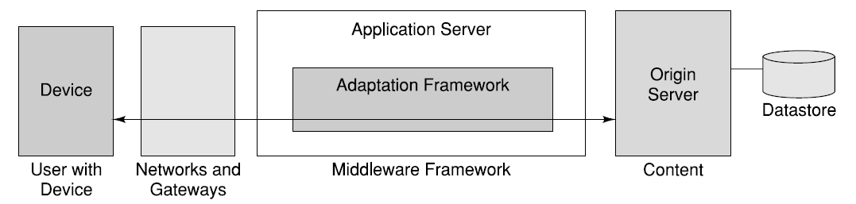
Mobile Computing Functions

Slide 23
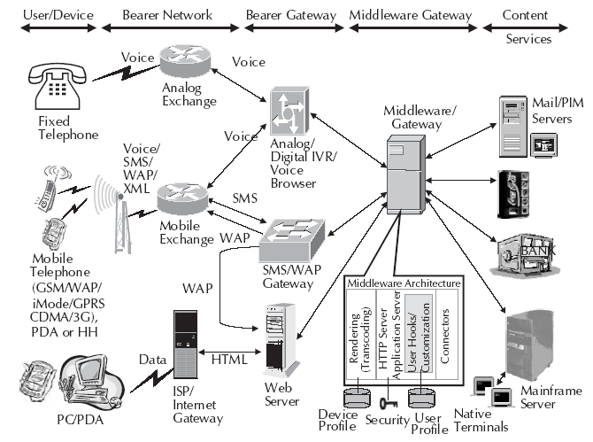
Mobile Computing Environment

Slide 24
Mobile Computing Devices
The usage of devices are becoming more and more integrated.
The Human Computer Interaction (HCI) plays a critical role in effectiveness, efficiency and user experience.
The challenges in HCI are:
Interaction must be consistent from one device to another.
Interaction has to be appropriate for a particular device and environment in which the system is being used.

Slide 25
Dialogue Control
There can be two types of user dialogues:
Long session oriented transactions
Short transactions

Slide 26
Networks for Mobile Computing
Mobile Computing can use different networks such as:
Fixed line telephone networks
GSM
GPRS
ATM
Frame Relay
ISDN
CDMA
CDPD
DSL and many more …

Slide 27
Middleware and Gateways
A software layer between a user application and operating system can be termed as middleware. Gateways are deployed when there are different transport bearers or networks with dissimilar protocols. The various types are:
Communication middleware
Transaction processing middleware
Behavior management middleware
Communication gateways
Database middleware
Message oriented middleware

Slide 28
Mobile Applications
Mobile application at static state (Portable Computing)
- Computing while being mobile (may not be networked)
Occasionally connected computing
- Computing while being mobile and occasionally connected
Vehicular (mobile and connected)
- Computing while being mobile and always connected

Slide 29
Mobile application attributes
It needs a multi layer architecture.
For data mobility, it needs network of networks.
For data portability, it needs data / file to be on a centralized server.
It requires a universal thin client (executable in any device) only to do the rendering at the device.
Execution environment should be independent of rendering.

Slide 30
Effect of mobility on protocol stack
Application
- adaptations with context awareness and security
Transport
- congestion, flow control, QoS and security
Network
- addressing, routing and security
Link
- media access and handoff
Physical
- transmission errors and interference

Slide 31
Limitations of Mobile Computing
Limitations of the wireless network
- heterogeneity of fragmented networks
- frequent disconnections
- limited communication bandwidth
Limitations imposed by mobility
- lack of mobility awareness by system / applications
- route breakages
Limitations of the mobile computer
short battery lifetime
limited capacities (memory, processing speed, etc.)

Slide 32
Categories of Applications and Services
There are six basic categories:
Personal (wallet, diary, etc.)
Perishable (news, sports, stock quotes, etc.)
Transaction oriented (bank transactions, mobile shopping, etc.)
Location specific (restaurant guide, map service, etc.)
Corporate (ERP, inventory, business alerts, etc.)
Entertainment (fun, games, etc.)

Slide 33
Examples of applications (1)
News: This is a very big basket of applications having different types of news. News could be political, current affair, breaking news, business news, sports news, community news, etc.
Youth: This is a very high growth market with different applications to suit the style and lifestyle of the youth. These are primarily messaging based application like person – to – person messaging, chat, forums, dating, etc.
Weather: There are different types of applications and services where mobile computing can make a difference. If we look at very closely when a person is on a vacation, and driving from one city to another, access to weather information can sometime save lives.

Slide 34
Examples of applications (2)
Corporate application: Standard corporate information is one of the most desirable information set for mobile workers. This will include corporate mail, address book, appointments, MIS applications, corporate Intranet, etc.
Sales Force Automation: This group will offer many applications. This will cater the large population of sales personnel. Applications will include sales order booking, inventory enquiry, shipment tracking, logistics related applications, etc. These applications will be very effective over wireless devices.
m-broker: Getting correct and timely information related to different stocks is very important. Also, online trading of stocks while on move is quite critical for certain lifestyle.

Slide 35
Examples of applications (3)
m-banking & telebanking: We need to access our banks for different transactions. If telebanking can be made ubiquitous, it shall help everybody. Many banks in India are offering banking over mobile phones using SMS.
m-shopping: It will help to do different types of shopping using mobile devices like Palmtop, PocketPC, mobile phone, etc. Buying a drink from a vending machine at an airport using a mobile phone may be very handy especially when you do not have change.
Micropayment based applications: Micropayments are these final transactions where the amount of money involved in a transaction is not very high. Micropayments using mobile phones can help rural people to do business in a much effective way.

Slide 36
Examples of applications (4)
Interactive games: Many mobile network operators have started offering different types of contest and interactive games to be played using mobile phone.
Interactive TV shows: Many TV companies around the world use SMS as a bearer for interactive TV. This has also started in Kenya where most leading TV companies are using SMS to make TV programmes interactive.
Experts on call: Application system for experts, where experts use this while they are mobile to schedule their time and business. Others use this to schedule business with the expert.
GPS based systems: Applications related to location tracking come under this category. This could be as simple as tracking a vehicle or even tracking an individual who got lost or struck due to bad weather.

Slide 37
Examples of applications (5)
e - governance: These applications are very important to bridge the digital divide. Examples include iTax and e-Citizen. Many such projects in the Government can be made electronic, resulting into better and faster access to information managed by the government.
Virtual laboratories: There are many labs and knowledge repositories around the world. These types of applications make the facility of these labs available across the boundary of culture and countries.
Community forums: There are different social and community meetings. On making them electronic, it may help increase the involvement of more people to participate in community developments.

Slide 38
Mobile Computing examples (6)
Job facilitator: These could be either proactive alerts or information related to jobs.
Telemetric applications: Almost every industry and sphere of life has the need for telemetric applications. Examples could be monitoring and control in manufacturing industry; vehicle tracking; meter reading; health care & emergency services; vending machine monitoring; research; control and service request for different emergency services like power plants; etc.
Downloads: Different types of downloads starting from ringing tone to pictures are part of this family. In many countries, these types of applications are very popular.

Slide 39
Mobile Computing examples (7)
Corporate knowledge based applications: Nowadays, there are many applications which offer knowledge base. If a company has some knowledgebase, the same is required to be ubiquitous.
Community knowledge based applications: Knowledge is power. Like in a corporation, knowledge is equally important for a community. Making knowledge ubiquitous always help the society at a large.
Distance learning: Applications related to distance learning may be very desirable for developing countries. MOOCs (Massive on line courses) is a good example; KUs Digital School.

Slide 40
Standards – Why are they necessary ?
Standards are documented agreements containing technical specifications to be consistently used as rules, guidelines, or definitions of characteristics.
Standard and Proprietary technologies
Adaptation of technology in USA and Europe

Slide 41
ETSI
European Telecommunications Standards Institute
It is an independent, non – profit standardization institution catering to telecommunications industry, based in Europe but having a worldwide scope.
ETSI’s prime objective is to support global harmonization by providing a forum in which all the key players can contribute actively.

Slide 42
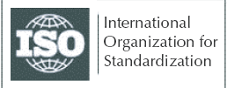
ISO
International Organization for Standardization
ISO is a worldwide federation of national standards bodies from more than 140 countries, one from each country.
The mission of ISO is to promote the development of standardization and related activities in the world with a view to facilitating the international exchange of goods and services, and to developing cooperation in the spheres of intellectual, scientific, technological and economic activity.

Slide 43

OMA
Open Mobile Alliance
The Open Mobile Alliance (OMA) has been established by the consolidation of the WAP Forum and the Open Mobile Architecture initiative.
It intends to grow the market for the entire industry by removing barriers to interoperability and supporting a seamless and easy-to-use mobile experience for end users.

Slide 44

IEEE
Institute of Electrical and Electronics Engineers
IEEE is an organization that produces standards, which are developed and used internationally.
IEEE-SA demonstrates strong support of an industry-led consensus process for the development of standards and operating procedures and guidelines.

Slide 45

EIA
Electronics Industry Association
EIA is a national trade organization within USA that includes the full spectrum of U.S. electronics industry.
EIA is a partnership of electronic and high-tech associations and companies whose mission is promoting the market development and competitiveness of the U.S. high-tech industry through domestic and international policy efforts.

Slide 46

ITU
International Telecommunications Union
ITU was founded on the principle of cooperation between governments and the private sector.
ITU Telecommunication Standardization Sector (ITU-T)’s mission is to ensure an efficient and on-time production of high quality standards (Recommendations) covering all fields of telecommunications.

Slide 47

W3C
World Wide Web Consortium
W3C develops interoperable technologies (specifications, guidelines, software, and tools) to lead the Web to its full potential.
By promoting interoperability and encouraging an open forum for discussion, W3C is committed to leading the technical evolution of the Web.

Slide 48

3GPP
3rd Generation Partnership Project
3GPP is to produce globally applicable technical specifications and technical reports for 3rd Generation mobile system.
The scope was subsequently amended to include the maintenance and development of the Global System for Mobile communication (GSM) technical specifications and technical reports including evolved radio access technologies.

Slide 49

ANSI
American National Standards Institute
ANSI plays an important part in creating international standards that support the worldwide sale of products, which prevent regions from using local standards to favor local industries.
ANSI has been one of the fore runner standards organization in computing for more than three decades.

Slide 50

UMTS
Universal Mobile Telecommunications System
UMTS is synonymous with a choice of WCDMA radio access technology that has already been selected by many licensees worldwide.
UMTS represents an evolution in terms of services and data speeds from today’s second generation mobile networks like GSM.

Slide 51

Bluetooth
Bluetooth wireless technology is a worldwide specification for a small-form factor, low cost radio solution that provides links between mobile computers, mobile phones, other portable handheld devices, and connectivity to the Internet.
The standards and specification for Bluetooth are developed, published and promoted by the Bluetooth Special Interest Group.

Slide 52

IMT 2000
International Mobile Telecommunications 2000
It is an ITU standard for 3G wireless communication.
It provides a framework for worldwide wireless access by linking diverse terrestrial and satellite networks.

Slide 53

CDG
CDMA Development Group
The CDG is an international consortium of companies who have joined together to lead the adoption and evolution of CDMA wireless systems around the world.
By working together, the CDG members will help ensure interoperability among systems, while expediting the availability of CDMA technology to consumers.

Slide 54

PAM Forum
Presence and Availability Management Forum
The Presence and Availability Management (PAM) Forum is an independent consortium with a goal to accelerate the commercial deployment of targeted presence and availability applications and services that respect users’ preferences, permissions and privacy.
PAM Forum will define a framework for the various standards and specifications needed for context/location aware applications.

Slide 55
Parlay Group
The Parlay Group is a multi – vendor consortium formed to develop open, technology – independent application programming interfaces.
Parlay integrates intelligent network (IN) services with IT applications via a secure, measured, and billable interface.
Parlay will also help develop location/context aware applications and services.

Slide 56

IETF
Internet Engineering Task Force
IETF is the standard-making body for Internet and related technologies.
IETF is an open international community of network designers, operators, vendors and researchers concerned with the evolution of the Internet architecture and the smooth operation of the Internet.

Slide 57

DECT
Digital Enhanced Cordless Communications
It is an ITSI standard for portable phones.
DECT is known in ITU as a 3G system and is commonly referred to as IMT-FT (IMT Frequency Time).

Slide 58

WiMAX Forum
Worldwide Interoperability for Microwave Access
WiMAX forum is dedicated to certifying the operations of interconnecting products.
WiMAX aims to provide wireless data over long distances in different forms ranging from point – to – point links to full scale mobile access networks.

Slide 59

TTA
Telecommunications Technology Association
TTA is an IT standards organization catering to development of new standards based in Korea.
It provides one stop services for comprehensive IT standards.

Slide 60

Wi-Fi Alliance
Wi-Fi owns trademark to Wi-Fi.
It was previously known as Wireless Ethernet Compatibility Alliance.
It is focused on interoperability and compatibility of Wi-Fi devices and pledges itself to continuous improvements in design and better user experience.

Slide 61

ARIB
Association of Radio Industries and Businesses
ARIB is an institution, based in Japan, dedicated to efficient use of radio spectrum and its implications in businesses.
It also works in the area of frequency change support.

Slide 62
CCSA
China Communications Standards Association
It is an attempt of Chinese Ministry of IT to adapt to reform telecommunications industry and market.
It aims for being a nationally unified standards organization in China.

Slide 63

DLNA
Digital Living Network Association
It is a cross-industry association of consumer electronics, computing industry and mobile device companies .
The objective of DLNA is to enable a seamless environment for sharing digital multimedia content across heterogeneous devices and networks.

Slide 64
Players in the wireless space
The stakeholders in the wireless network are:
Regulatory authorities
Operator or service provider
Subscriber
Equipment vendors
Research organizations

Slide 65
Next Topic
Mobile Computing Architecture
Thank You

